Slide 1
Classical Bits and Gates

Slide 2
Overview
In this lesson we’ll cover:
What are bits?
How do we convert information into binary?
What are four different gates?
How to create a truth table?
How do we deal with errors?

Slide 3

What makes a computer, a computer?
Notes:
4 features are:
Computers used in the past week: phone, laptop, clusters, smart watch

Slide 4


What are bits?
ⓘ
Click Present with Slido or install our Chrome extension to activate this poll while presenting.
Notes:
📣 This is Slido interaction slide, please don't delete it. ✅ Click on 'Present with Slido' and the poll will launch automatically when you get to this slide.

Slide 5

What are different pairs of mutually exclusive states that we can use as bits?
ⓘ
Click Present with Slido or install our Chrome extension to activate this poll while presenting.
Notes:
📣 This is Slido interaction slide, please don't delete it. ✅ Click on 'Present with Slido' and the poll will launch automatically when you get to this slide.

Slide 6
Classical Bits
.
OFF ON
FALSE TRUE
0 1

Slide 7

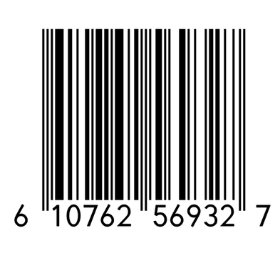
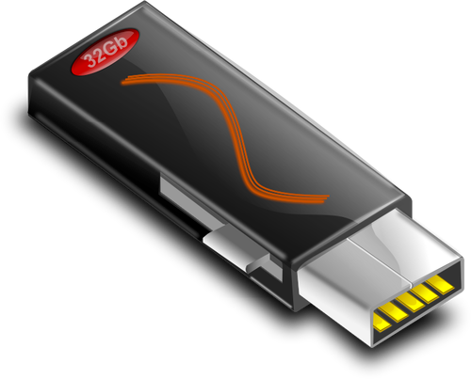
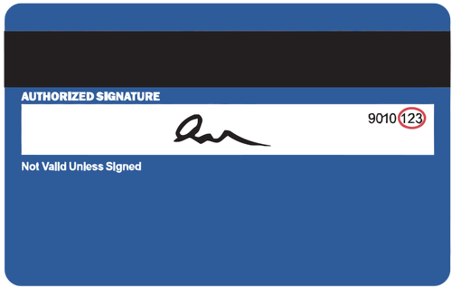
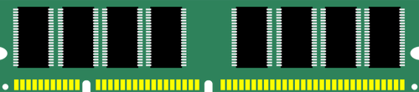

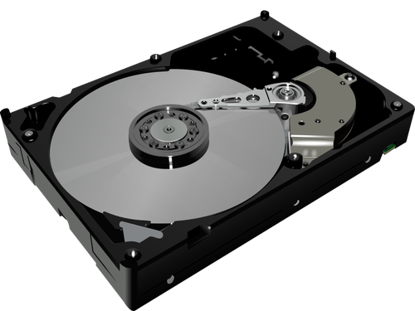
Bit Implementations
presence or absence of material
magnetization up or down
current on or off
Quantum bits also have different possible implementations!

Slide 8
Decimal vs Binary
Decimal: 0 through 9
10³ = 1000 10² = 100 10¹ = 10 10⁰ = 1
Binary: 0 through 1
2⁴=16 2³ = 8 2² = 4 2¹ = 2 2⁰ = 1

Slide 9

Binary Puzzle #1
What’s your age (or another number) in binary?
2⁵=32 2⁴=16 2³ = 8 2² = 4 2¹ = 2 2⁰ = 1
Worksheet
Puzzle

Slide 10
Binary Puzzle #2
We can encode letters as numbers:
What’s your name or your initials in binary?
(Note: You’ll need 1 “bitstring” for each letter.)
2⁴=16 2³ = 8 2² = 4 2¹ = 2 2⁰ = 1
A | B | C | D | E | F | G | H | I | J | K | L | M | N | O | P | Q | R | S | T | U | V | W | X | Y | Z
1 | 2 | 3 | 4 | 5 | 6 | 7 | 8 | 9 | 10 | 11 | 12 | 13 | 14 | 15 | 16 | 17 | 18 | 19 | 20 | 21 | 22 | 23 | 24 | 25 | 26
Worksheet
Puzzle

Slide 11
Now that we
understand binary,
let’s look at how we can manipulate bits using gates.

Slide 12
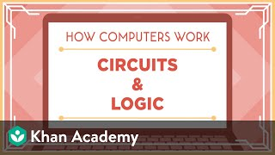
Circuits and Logic

Slide 13
What are some basic gates?
ⓘ
Click Present with Slido or install our Chrome extension to activate this poll while presenting.
Notes:
📣 This is Slido interaction slide, please don't delete it. ✅ Click on 'Present with Slido' and the poll will launch automatically when you get to this slide.

Slide 14
Circuits and Logic
The video mentions NOT, AND, OR, XOR, NAND, NOR
These are “classical” gates. Not all of them make sense for quantum computers!
“Quantum” gates must:
have the same number of input and output bits
be reversible: each input has a unique output

Slide 15


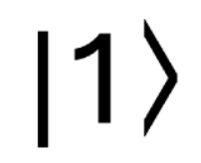
Logic Gates: NOT Gate
Input Output
The NOT gate changes the value of the input bit to what it is not.

Slide 16
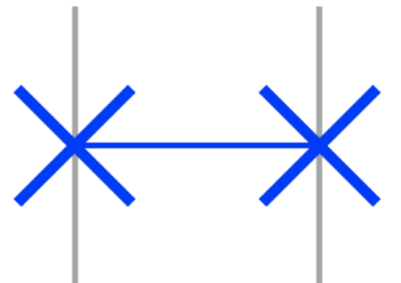
Logic Gates: SWAP Gate
Input Output
Input Output
Input Output
Input Output
The SWAP Gate allows the input bit values to swap positions.

Slide 17
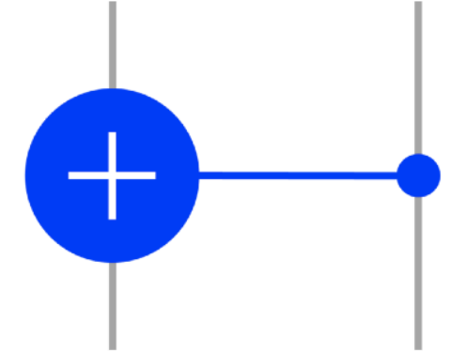
Logic Gates: CNOT Gate
Target
Target
Input Output
Input Output
Control
Control
Target
Target
Input Output
Input Output
Control
Control
If the control bit is 1, the target bit flips to the other value.

Slide 18
Let’s work through an example circuit together.

Slide 19

Example Circuit #1
Worksheet
Puzzle

Slide 20

Example Circuit #1
Worksheet
Puzzle

Slide 21
Example Circuit #1
Worksheet
Puzzle

Slide 22
Example Circuit #1
Worksheet
Puzzle

Slide 23
Now you try one!

Slide 24
Example Circuit #2
Worksheet
Puzzle

Slide 25
Example Circuit #2
Worksheet
Puzzle

Slide 26
Example Circuit #2
Worksheet
Puzzle

Slide 27
Example Circuit #2
Worksheet
Puzzle

Slide 28
Circuit Game!

Slide 29
Bits and Gates Circuit Game
2-bits (easier):
Roll a D4 once to determine the input state and once to determine the output state:
Roll a D6. This is the number of credits you have available to spend on gates. Choose gates to apply to your input bit to get the appropriate output.
 | 1 | 2 | 3 | 4
Q0 | 0 | 0 | 1 | 1
Q1 | 0 | 1 | 0 | 1
3-bits (harder):
Roll a D8 once to determine the input state and once to determine the output state:
Roll a D8. This is the number of credits you have available to spend on gates. Choose gates to apply to your input bit to get the appropriate output.
 | 1 | 2 | 3 | 4 | 5 | 6 | 7 | 8
Q0 | 0 | 0 | 0 | 0 | 1 | 1 | 1 | 1
Q1 | 0 | 0 | 1 | 1 | 0 | 0 | 1 | 1
Q2 | 0 | 1 | 0 | 1 | 0 | 1 | 0 | 1
When you have completed your circuit, have a partner check your work and tally up your score! If you made a mistake, go back and fix it.
Whoever scores the most points (for correct circuits) wins!
Credit Cost | Gate | Point Award
1 | NOT | 1
2 | SWAP | 2
2 | CNOT | 3
If you don’t have coins/dice, use https://rolladie.net

Slide 30
Sometimes computers make mistakes.
Let’s briefly discuss error detection and correction.

Slide 31
Errors in Classical Bits
Sometimes, bits can flip from 0 to 1 or 1 to 0.
cosmic rays, radiation from nuclear testing and particle accelerators
degradation of signal while transmitting through cables or air
many types of errors are random events – probability lesson is tomorrow!
How can we detect errors?
Repetition Code - multiple physical bits encode a single logical bit:
00 encodes 0
11 encodes 1
To send the number 12 in binary (1100): 11 11 00 00
This is called a repetition code.

Slide 32
Errors in Classical Bits
Sometimes, bits can flip from 0 to 1 or 1 to 0.
cosmic rays, radiation from nuclear testing and particle accelerators
degradation of signal while transmitting through cables or air
many types of errors are random events – probability lesson is tomorrow!
How can we correct errors?
Majority rule - correct the error to the majority number:
001, 010, 100 → 000,
110, 101, 011 → 111.
This is called an error correction code.

Slide 33
We can represent gates with truth tables.

Slide 34
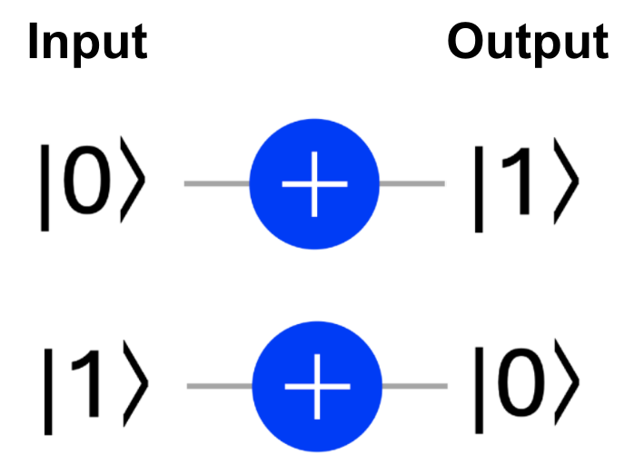
Truth Tables: NOT Gate
Input | Output
0
1
Worksheet
Puzzle

Slide 35
Truth Tables: NOT Gate
Input | Output
0 | 1
1 | 0
Worksheet
Puzzle

Slide 36
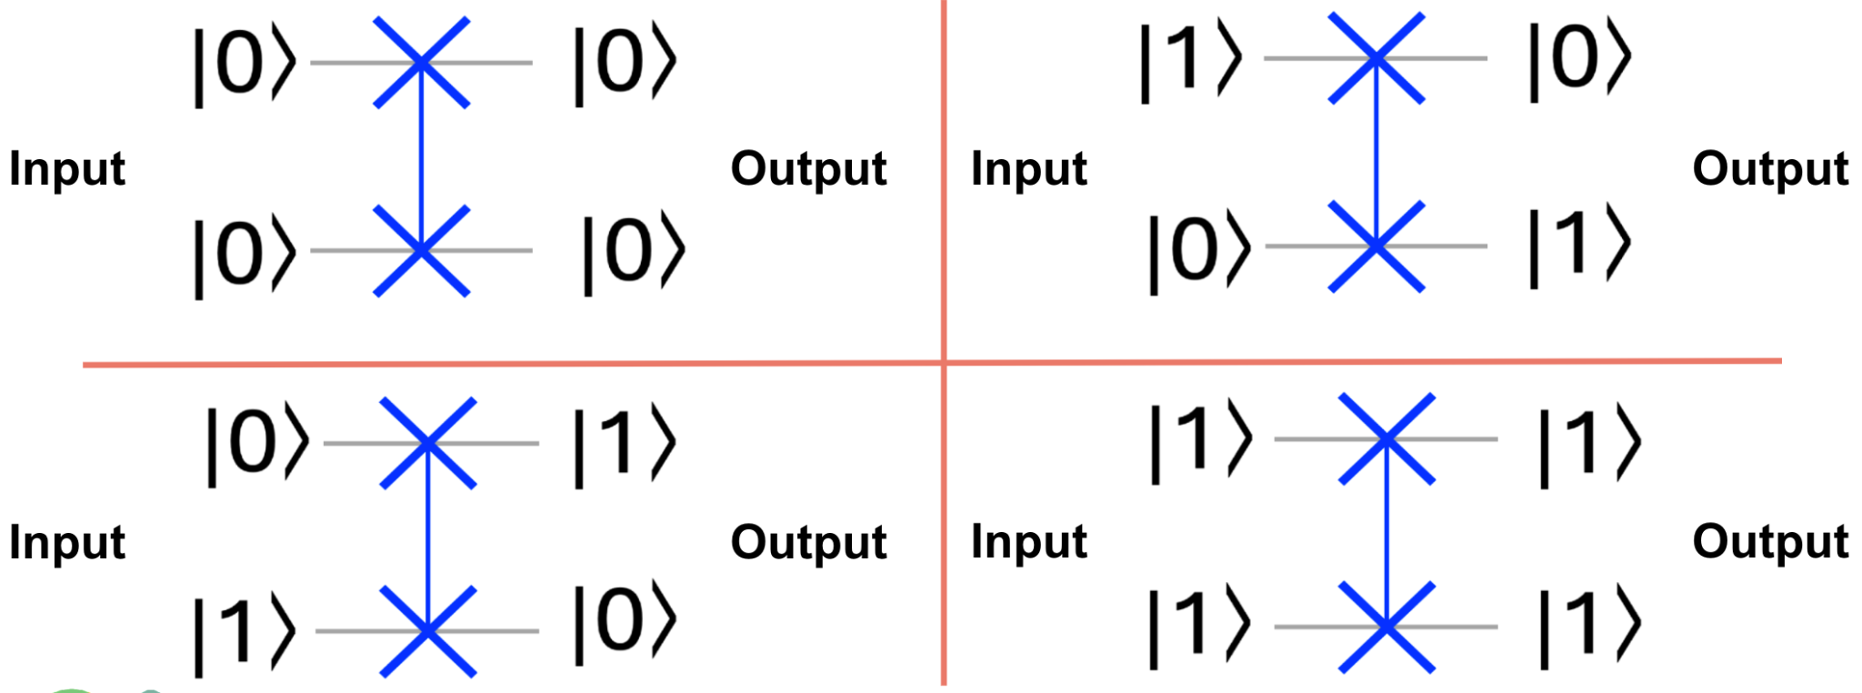
Truth Tables: SWAP Gate
Input 1 | Input 2 | Output 1 | Output 2
0 | 0
0 | 1
1 | 0
1 | 1
Worksheet
Puzzle

Slide 37
Truth Tables: SWAP Gate
Input 1 | Input 2 | Output 1 | Output 2
0 | 0 | 0 | 0
0 | 1 | 1 | 0
1 | 0 | 0 | 1
1 | 1 | 1 | 1
Worksheet
Puzzle

Slide 38
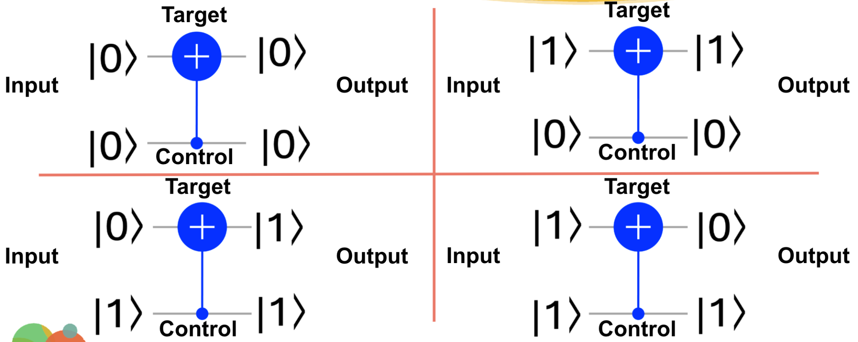
Truth Tables: CNOT Gate
Control | Target | C Output 1 | T Output 2
0 | 0
0 | 1
1 | 0
1 | 1
Worksheet
Puzzle

Slide 39
Truth Tables: CNOT Gate
Control | Target | Output 1 | Output 2
0 | 0 | 0 | 0
0 | 1 | 0 | 1
1 | 0 | 1 | 1
1 | 1 | 1 | 0
Worksheet
Puzzle

Slide 40
More Puzzles!

Slide 41
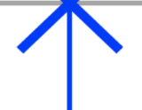
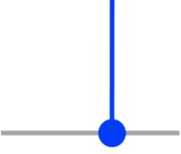
Example Circuit #3

Slide 42
Example Circuit #3

Slide 43
Example Circuit #3

Slide 44
Example Circuit #3

Slide 45
Example Circuit #4

Slide 46
Example Circuit #4

Slide 47
Example Circuit #4

